Slide 1

Capstone Project
The battle of neighborhoods

Slide 2

Probject description

Slide 3
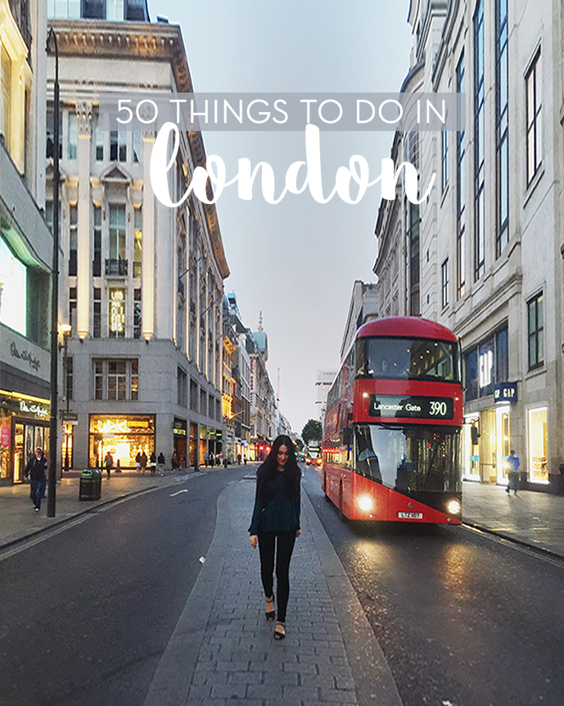
As a tourist visiting London the capital of the United Kingdom and the largest city of the Europe Union, it would be helpful having an idea of best places to visit before landing.
Therefore, this project aims to implement a recommender system to suggest the best places to visit giving certain people preferences. This can be done by finding and filtering different venues. Locating and suggesting the most interesting neighborhoods based on the preferences can be performed based on the number of visitors, likes, prices, rating …etc.

Slide 4
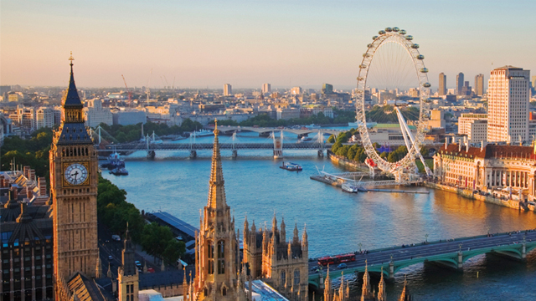
description of the data

Slide 5

FOURSQUARE PLACES API
In this project we use Foursquare Places API to obtain details about venues in London including location, tips, categories etc… This is possible by the use of a explore call that returns a list of recommended locations in a specified area. After getting a list of all venues, we use then venue calls to get statistics about each one.
OTHER DATA SOURCES
A List of London district names with Postal codes to match with API Foursquare data and are retrieved from: https://en.wikipedia.org/wiki/List_of_areas_of_London

